Slide 1

Twitter Semantic Analysis
-BY GrOUP 5
Mentor-Neha

Slide 2
Objective:
The primary objective is to classify tweets into different sentiment categories, such as Regular, Sarcasm, Figurative and Irony. This helps in understanding the overall sentiment trends related to a particular topic, brand, event, or public figure.
Analyzing the sentiment of tweets over time can provide valuable insights into changing trends and public opinions. It helps in understanding how sentiment evolves in response to events, news, or social phenomena.

Slide 3
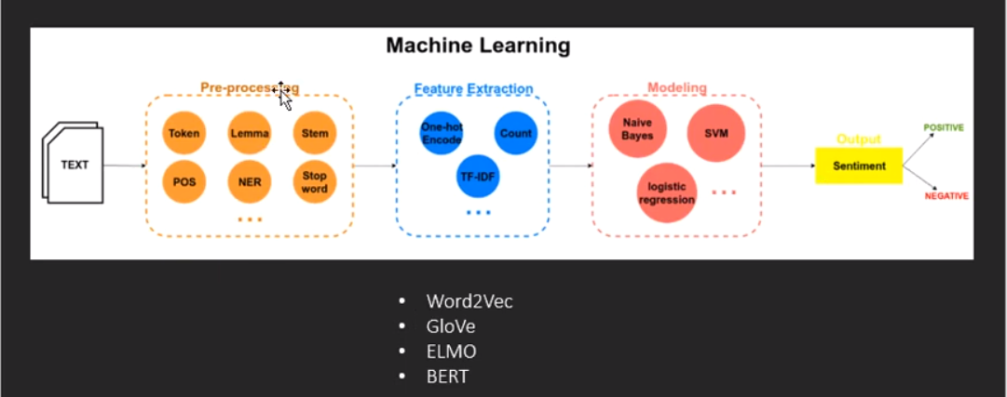
Work Flow:

Slide 4
Exploratory Data Analysis (EDA) and Feature Engineering
Rows, columns – (81408, 3)
unique characteristics-['figurative', 'irony', 'regular', 'sarcasm']
Checking for duplicate data- 49
The value counts of each class-figurative-21235 irony-20877 sarcasm-20678
regular-18569

Slide 5
Data Cleaning
Making text lowercase
remove text in square brackets
remove punctuation
remove words containing numbers
Removing URL's, hashtags, mentions, and special characters.
Removing stopword.
Stemming
Tokenization

Slide 6
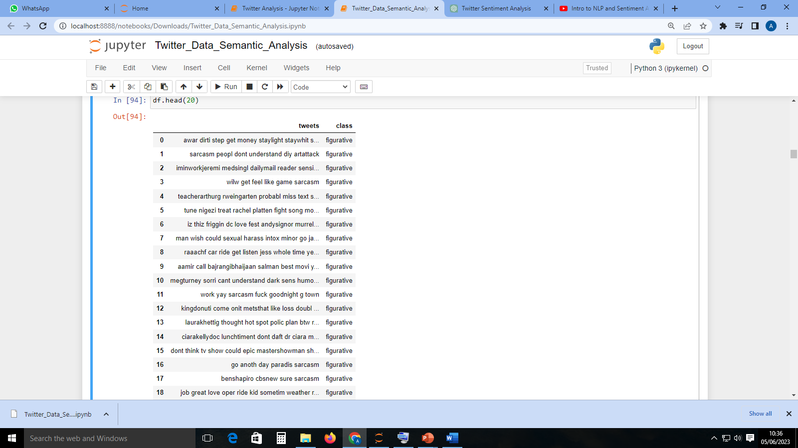
Data Cleaning

Slide 7
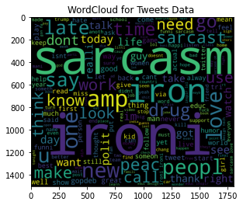
Wordcloud for entire corpus

Slide 8
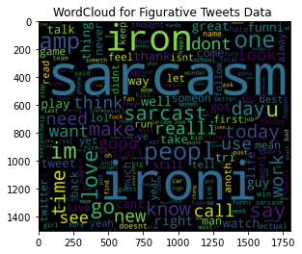
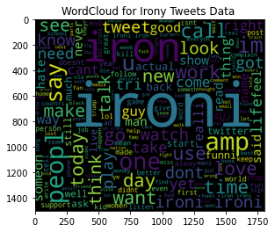
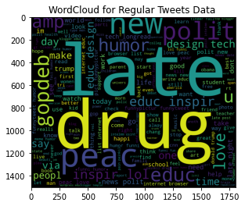
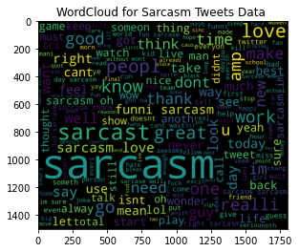
Wordcloud for Specific Class

Slide 9
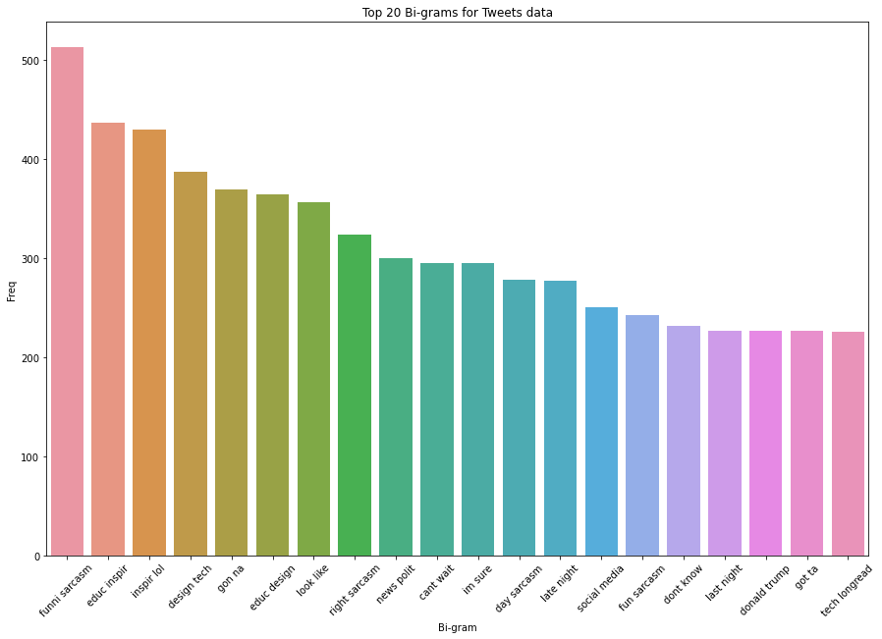
Top 20 Bi-gram Bar chart for Tweets Data

Slide 10
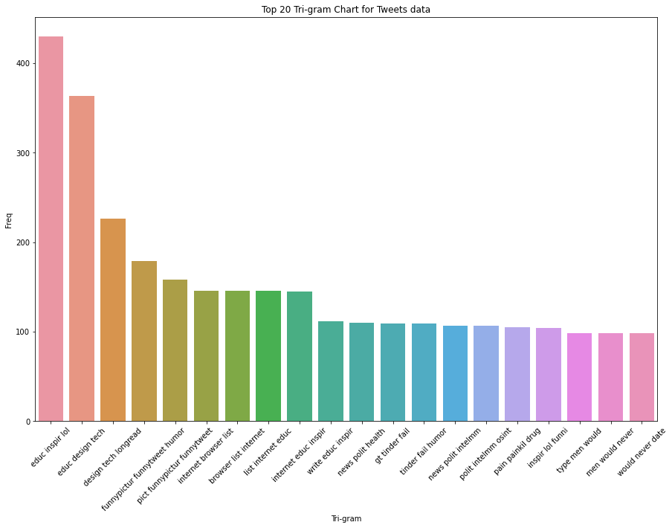
Top 20 Tri-gram Bar chart for Tweets Data

Slide 11
Feature Extraction
Splitting data for training and testing
TFIDF Vectorization: TF-IDF vectorization involves calculating the TF-IDF score for every word in your corpus relative to that document and then putting that information into a vector
Using Naïve Bayes Model: The Naïve Bayes classifier is a supervised machine learning algorithm, which is used for classification tasks, like text classification. It is also part of a family of generative learning algorithms, meaning that it seeks to model the distribution of inputs of a given class or category.

Slide 12
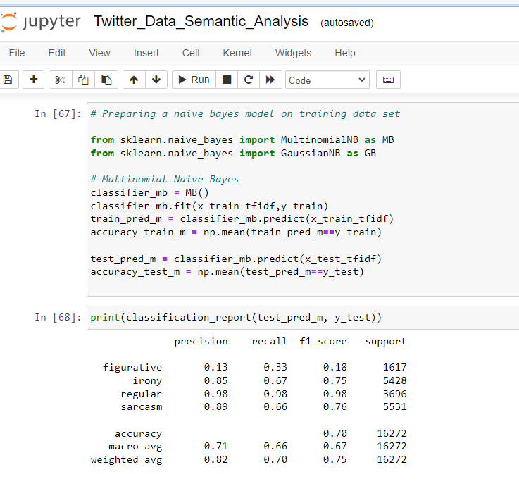

Slide 13
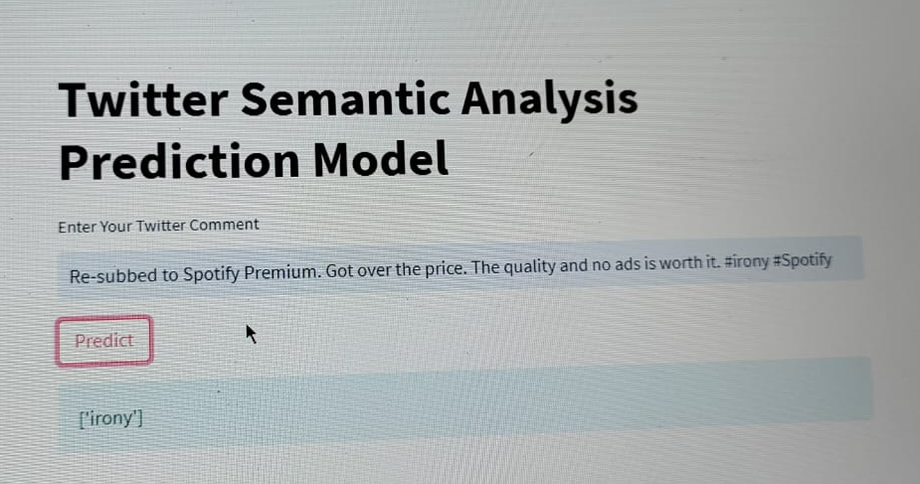
Model Deployment:
Model Deployment through Streamlit.
Streamlit is a free and open-source framework to rapidly build and share beautiful machine learning and data science web apps. It is a Python-based library specifically designed for machine learning engineers.

Slide 14
Challenges:
Twitter sentiment analysis faces several challenges due to the unique characteristics of the Twitter platform and the nature of tweets. Some of the key challenges include:
Short and Noisy Text -Moreover, tweets can be highly informal, containing slang, abbreviations, typos, and grammatical errors, adding noise to the text.
Contextual Understanding: Twitter sentiment analysis often struggles with understanding the context in which tweets are written. Tweets can Regular, Sarcasm, Figurative and Irony that require a deeper understanding of the broader context to accurately interpret the sentiment.
Handling Emojis, Hashtags, and Emoticons: Twitter users heavily utilize emojis, hashtags, and emoticons to convey emotions and add context to their tweets. Incorporating these elements into sentiment analysis requires proper handling and interpretation to capture their sentiment-rich information accurately.

Slide 15
Conclusion:
Twitter sentiment analysis helps in various domains, including brand monitoring, customer feedback analysis, crisis management, trend analysis, and market research. It provides businesses with actionable insights for reputation management, product improvement, customer service, and decision-making processes.
Furthermore, ongoing research and development in the field of sentiment analysis continue to address challenges such as handling noisy and informal text, contextual understanding, data sparsity, and user bias. These efforts aim to improve the accuracy, adaptability, and scalability of sentiment analysis models specifically designed for Twitter data.
In a fast-paced and opinion-rich platform like Twitter, sentiment analysis serves as a valuable tool for monitoring, understanding, and leveraging public sentiment to drive positive outcomes and informed strategies.

